Slide 1

Welcome back assembly
January 2023

Slide 2



Slide 3



NEW YEAR RESOLUTIONS…

Slide 4
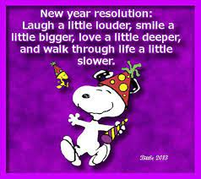

Slide 5

Three Rules
We are respectful
We are responsible
We are safe
P4-7

Slide 6

P1-4

Slide 7


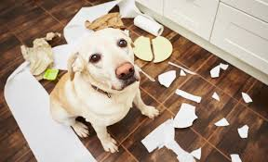
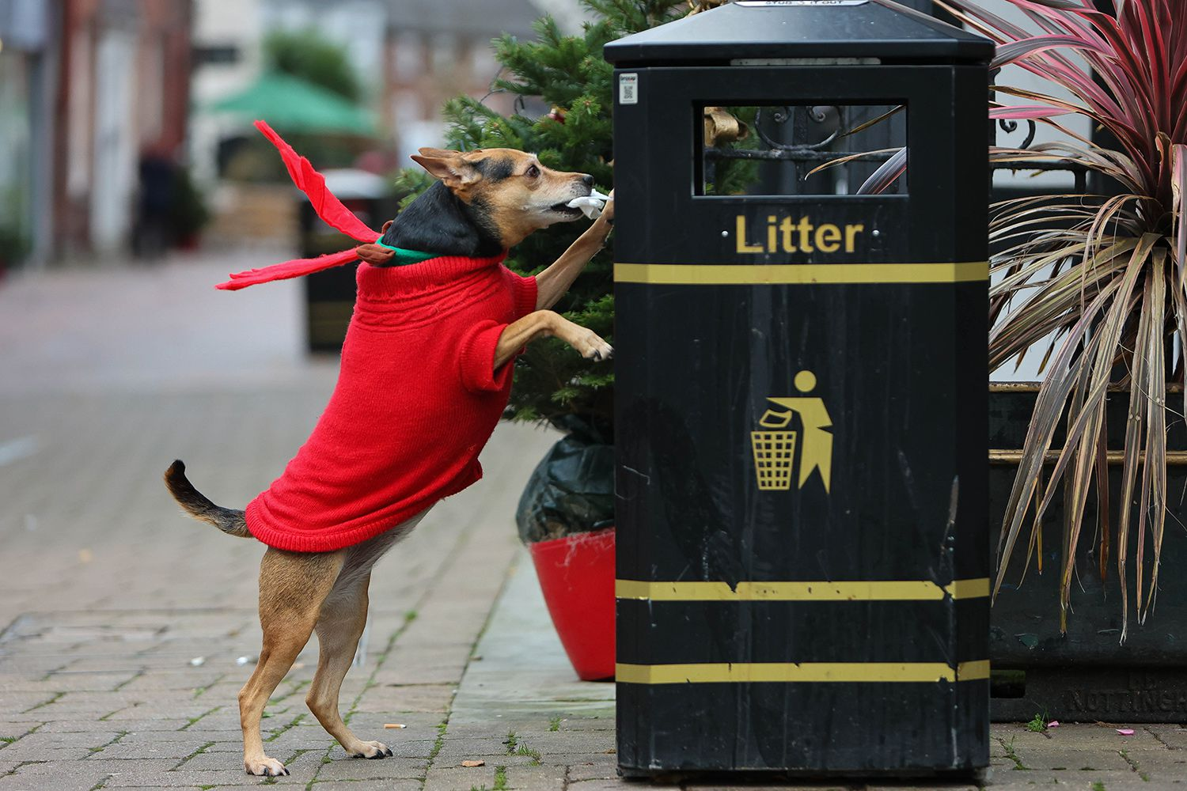

Slide 8


Slide 9
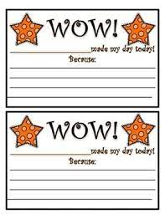
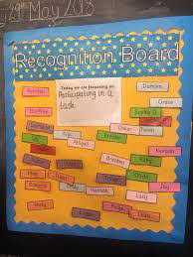
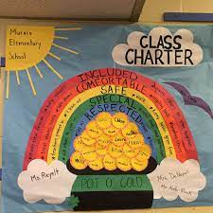
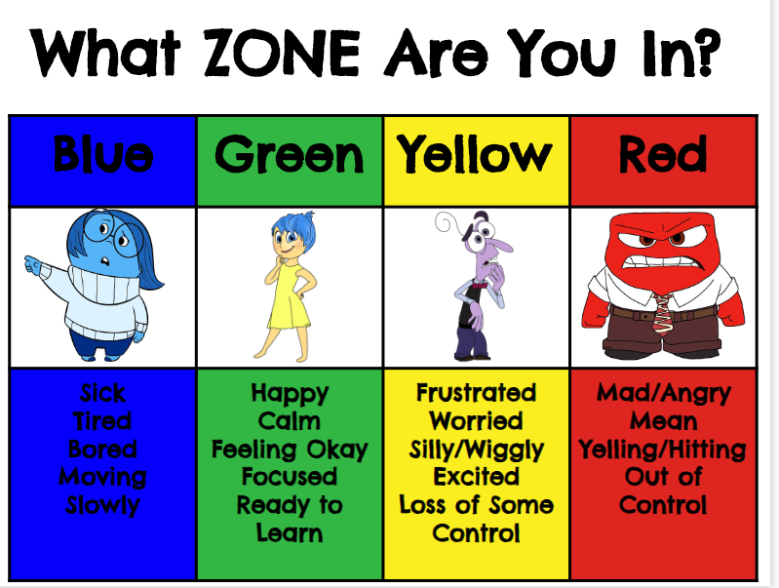
How do we promote positive relationships in our class?

Slide 10

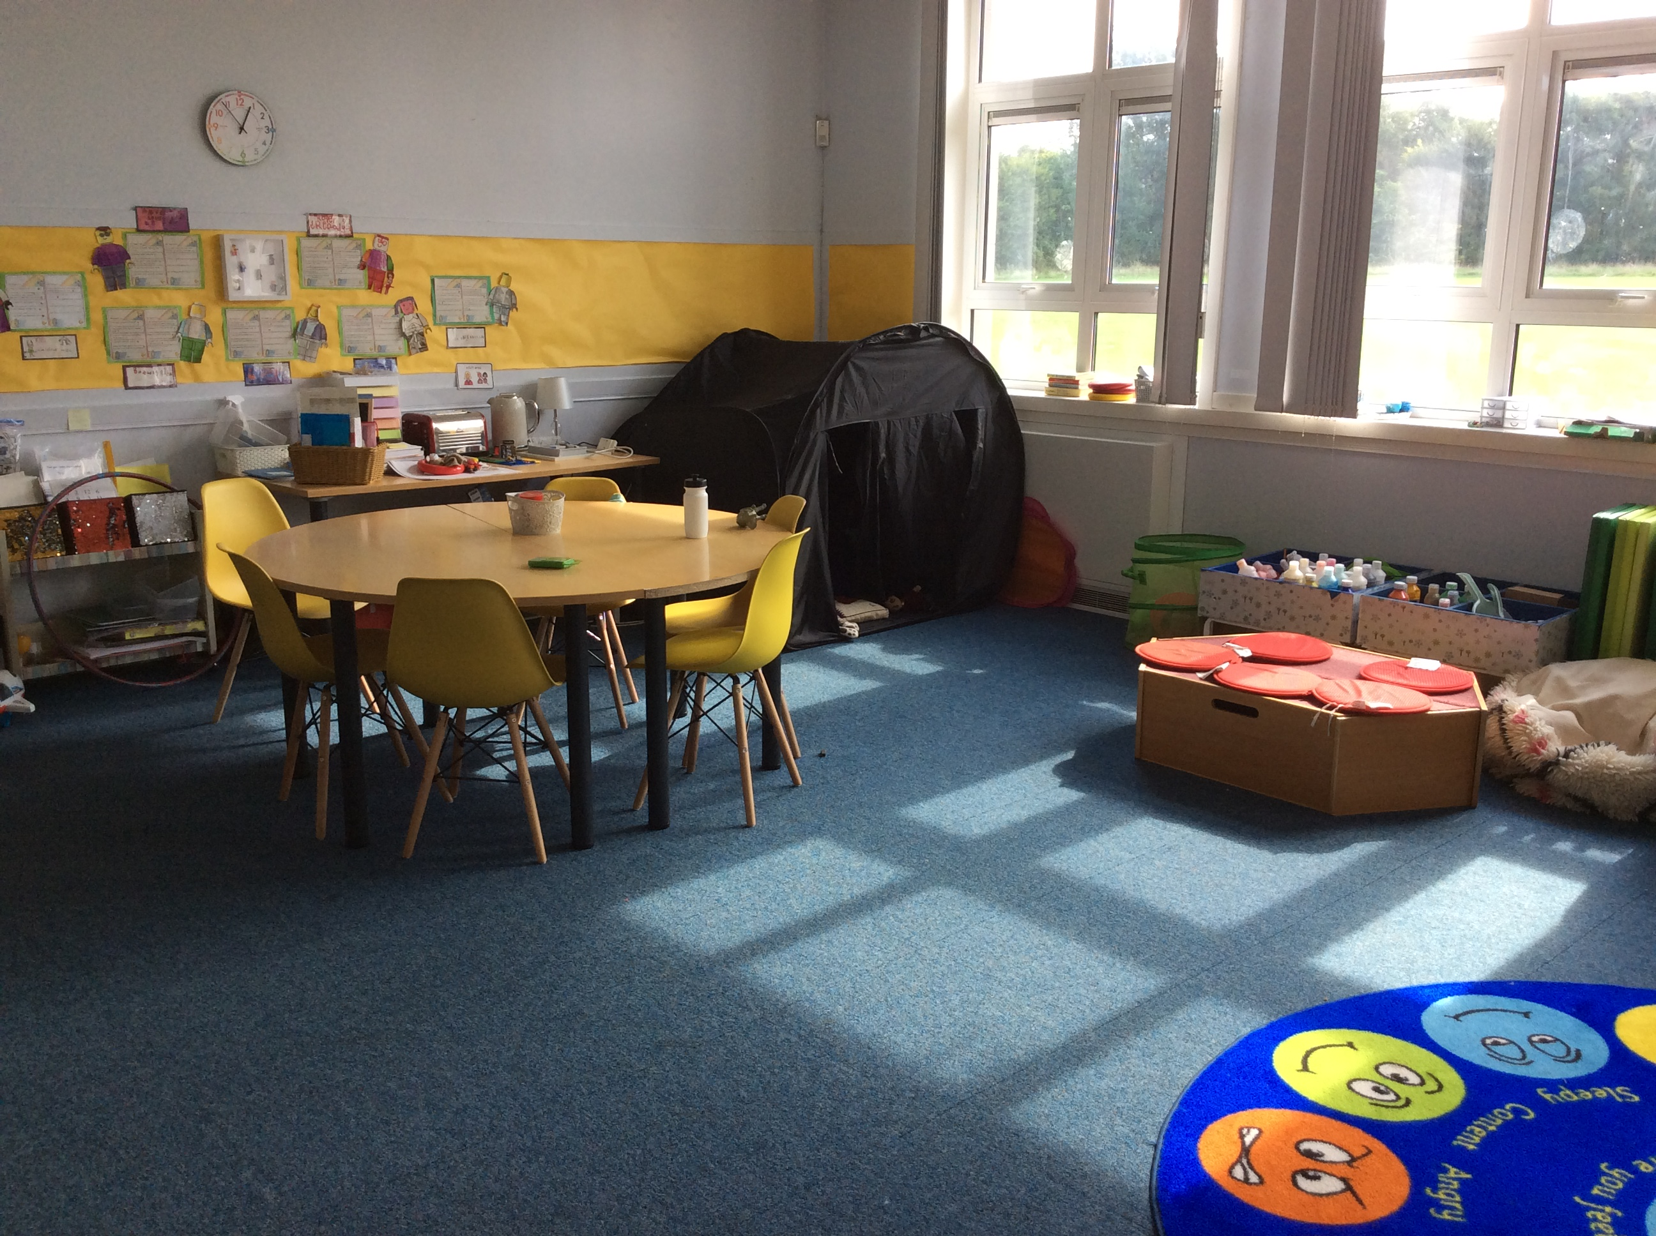

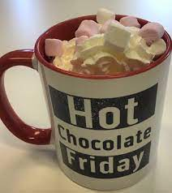


How do we promote positive relationships around the school?
Green Cards

