Slide 1
Chinese New
Year

Slide 2
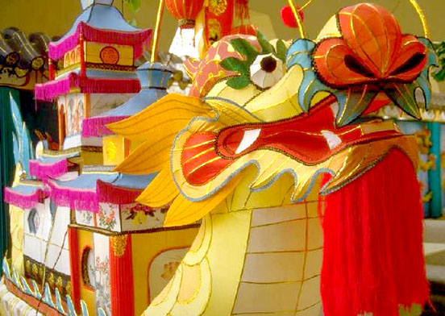
Chinese New Year
Chinese New Year usually falls around January or February.
In Chinese culture, it's a time when people gather together with their families, decorate their homes with colourful lanterns, and celebrate the new year.
But how much do you know about the festival?

Slide 3
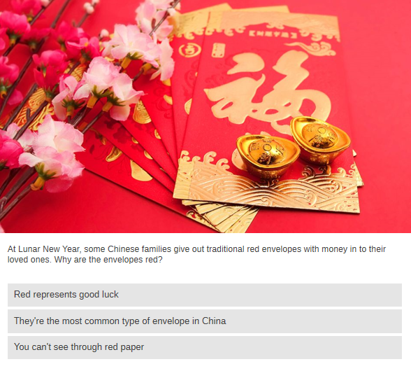


Slide 4
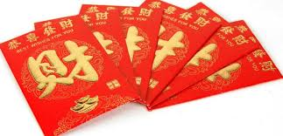
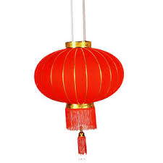
Red represents good luck –
Money is given to family and close friends in envelopes made of red paper, which symbolises good luck and fortune.
Decorating homes with red lanterns is also said to bring good luck to the home.

Slide 5


Slide 6
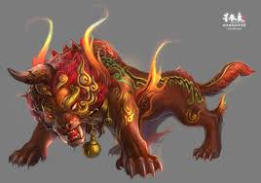
To drive away evil –
According to an old legend, burning bamboo would create loud noises that scared away a monster called Nián.
This developed the tradition of using fireworks to create the loud noises and bright lights needed to keep evil spirits away.

Slide 7
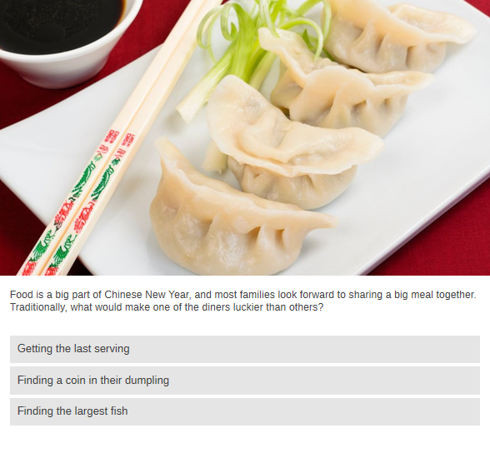

Slide 8
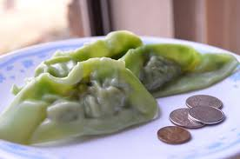
Finding a coin in their dumpling –
The old Chinese tradition of hiding a coin inside one of the New Years Eve dumplings is said to bring the one who finds it good luck, although it’s not a common thing to do now.

Slide 9
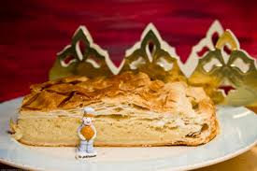
Does Chinese New Year remind you of any other customs?
We are learning about and comparing different cultures.
We are learning
about and
comparing different
cultures.

Slide 10

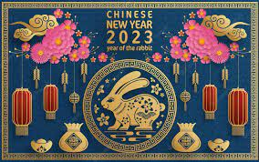

Film
Chinese New Year - BBC Teach

Slide 11


Slide 12
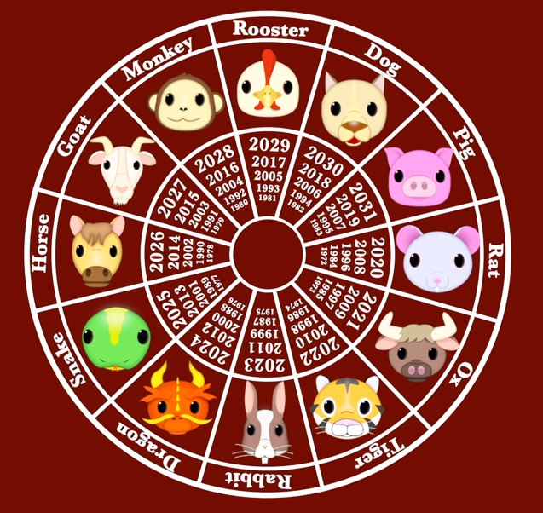
The Chinese New Year Legend
The Chinese New Year calendar has 12 years in a cycle. Each cycle is named after an animal, in a particular order. There are several legends that explain how this came about.
Chinese Zodiac: 12 Animals, Personality Traits and Cultural Aspect (chineasy.com)

Slide 13
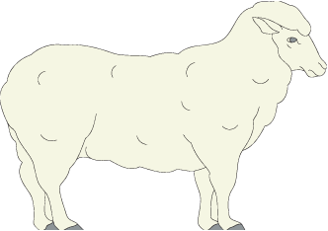
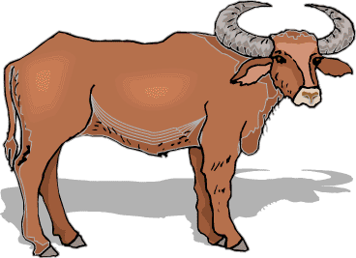

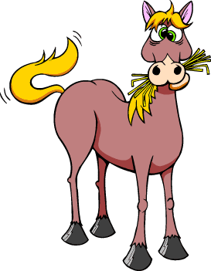


Meet the animals…

Slide 14

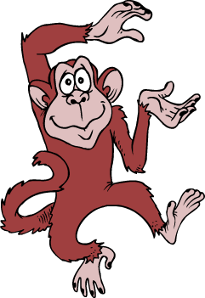
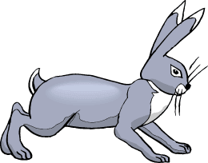
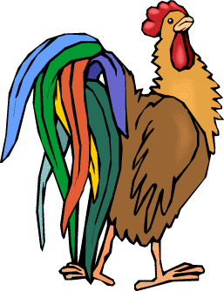
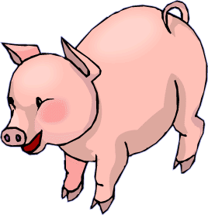

Meet the animals…

Slide 15

Chinese New
Year
chinese zodiac story video - Google Search

Slide 16
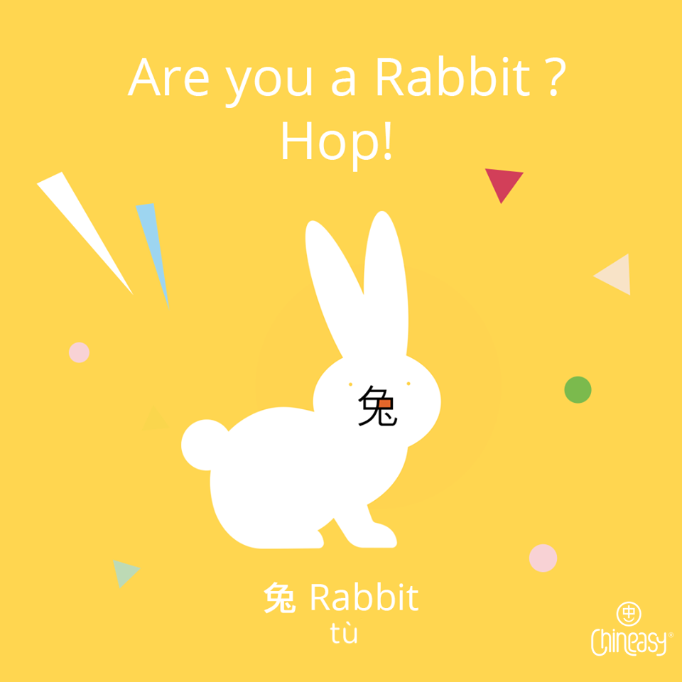
P7 2011
兔

Slide 17
Year of the Rabbit 2011 (P7)
Rabbits are affectionate, co-operative and pleasant, with lots of friends. But they can get too sentimental and seem superficial. Ideal careers areas include law, diplomacy or the stage.

Slide 18
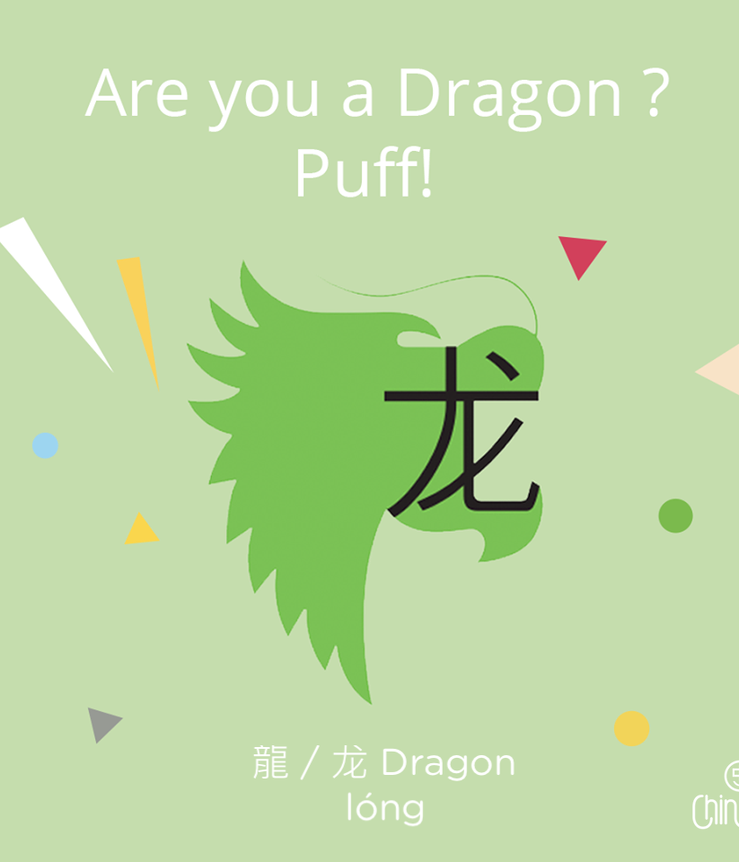
P7/6 2012
龙

Slide 19
Year of the Dragon 2012 (P7, P6)
Dragons tend to be popular individuals who are always full of life and enthusiasm, with a reputation for being fun-loving. They make good priests, artists and politicians.

Slide 20
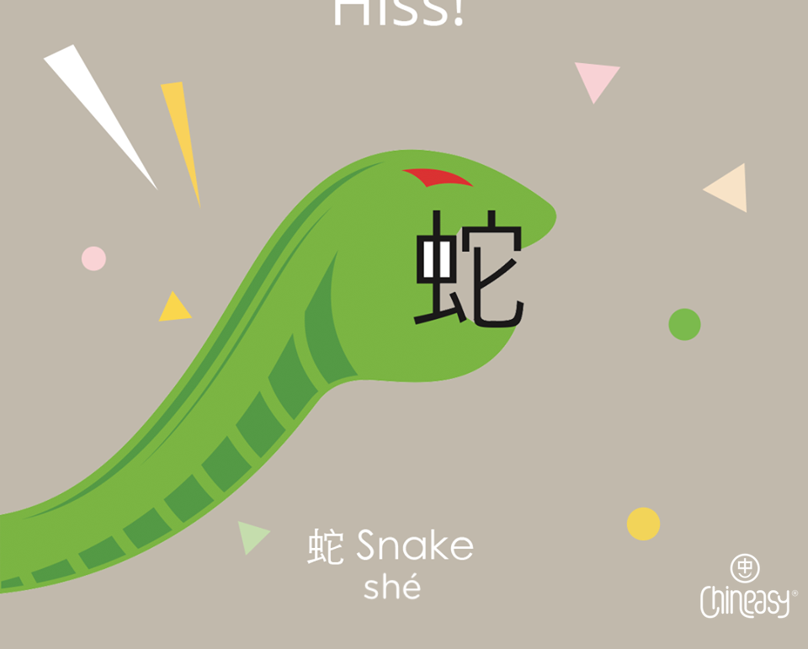
P6/5 2013
蛇

Slide 21
Year of the Snake 2013 (P6, P5)
People born in the year of the Snake are romantic and deep-thinking, wise and charming, although they tend to dismiss others too quickly and are a bit stingy with money. Ideal jobs include teaching.

Slide 22
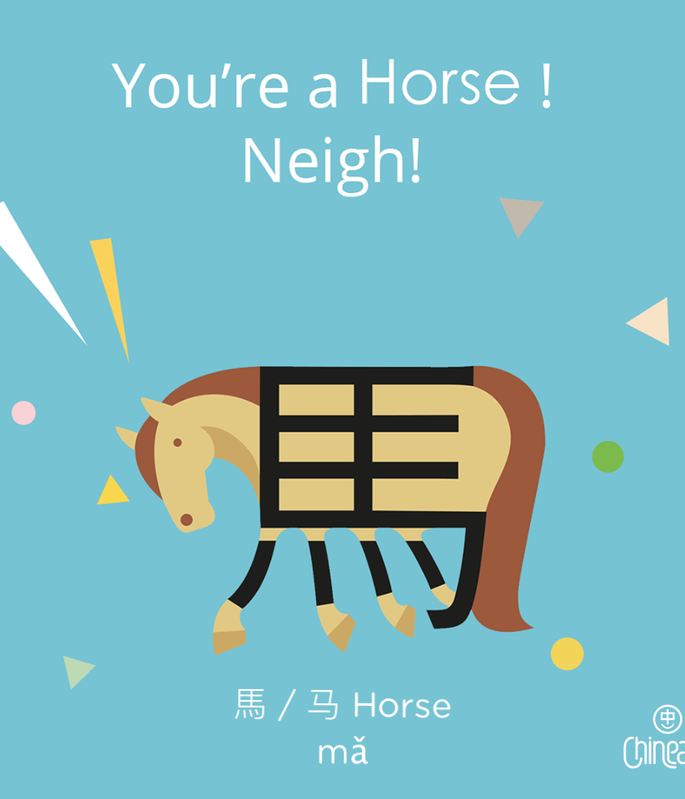
P5/4 2014
馬

Slide 23
Year of the Horse 2014 (P5, P4)
If you are born in the Year of the Horse then you are amazingly hard working and very independent. Although you are intelligent and friendly, you can sometimes be a bit selfish. Career wise you
would make a good scientist
or poet.

Slide 24
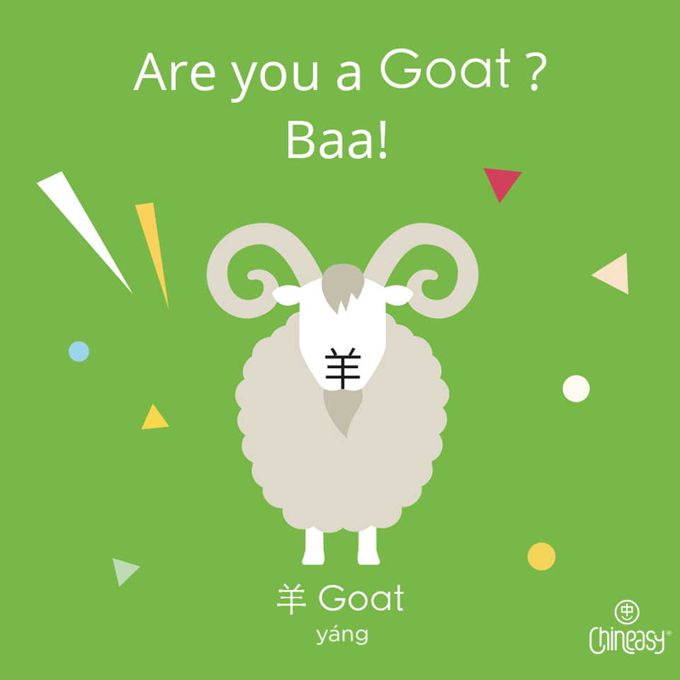
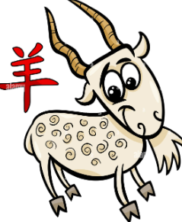
P4/3 2015
羊

Slide 25
Year of the Goat 2015 (P4, P3)
If you are born in the Year of the goat then you are a peaceful and lucky person. You are also calm and do not like conflict. Steve Jobs who created Apple was a goat! Maybe you’ll come up with the next great invention!

Slide 26
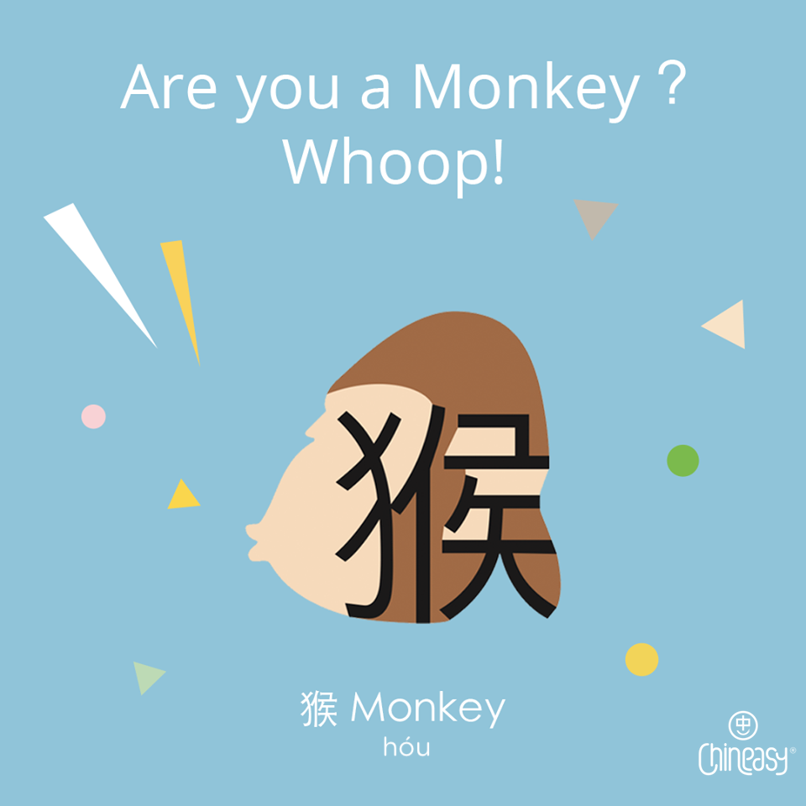
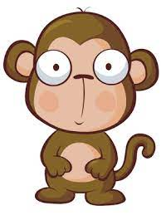
P3/2 2016
猴

Slide 27
Year of the Monkey - 2016 (P3,P2)
Monkeys are clever, curious and a bit
cheeky! You are creative too and can solve the most difficult problems. You are a born leader and could be a successful lawyer, teacher, writer or actor!

Slide 28
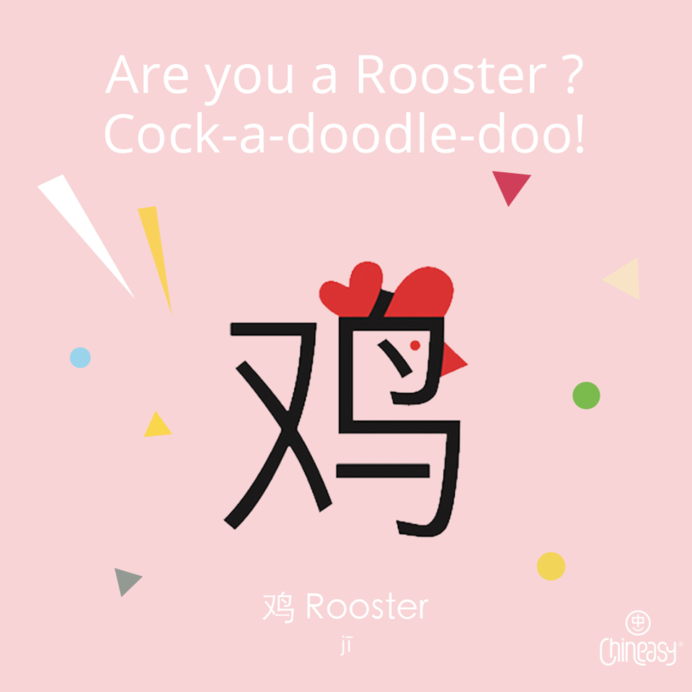
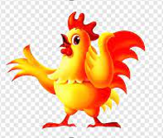
P2/1 2017
鸡

Slide 29
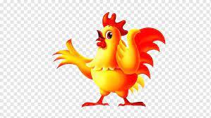
Year of the Rooster - 2016 (P2,P1)
You are a good friend. You are good at being on time and you wake people up on time. You are kind-hearted, hard-working, courageous, independent, humorous and honest. You like to keep your home neat and organised! You would make a good police officer,
fashion designer or spy!

Slide 30
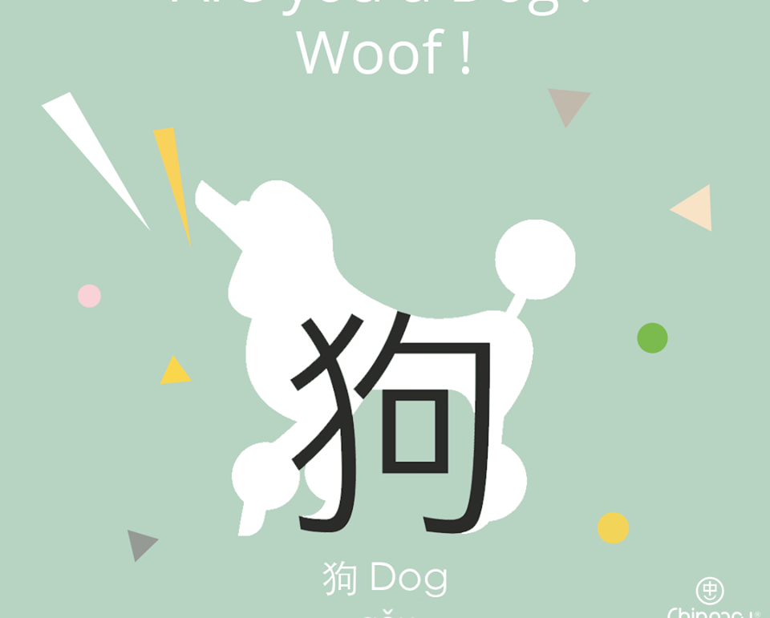
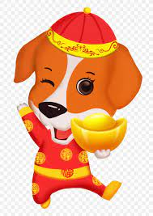
P1 2018
狗

Slide 31
Year of the Dog - 2018 (P1)
You are very loyal to your friends. You tell the truth and are friendly. You are good at helping others and you never give up. You would make a good lawyer, judge, teacher or doctor.

Slide 32
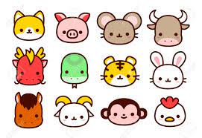
Zodiac Quiz
What Chinese Zodiac Animal Is Closest To Your Personality? (buzzfeed.com)

Slide 33
