Slide 1


Digital Safety
City of Edinburgh Council
Digital Learning Team

Slide 2
What do children do online?
Use social media to connect with friends like Facebook or Twitter
Play games alone and with others through websites, apps or consoles
Search for information on search engines like Google
Share images and watch videos through apps or sites like Instagram and SnapChat
Send and receive messages through apps such as WhatsApp and iMessage

Slide 3
When online, children and young people can learn new things, get help with homework, express themselves creatively and connect with friends and family.
There are also risks, but by understanding and talking about the dangers you can help keep your child safe online.
-NSPCC

Slide 4
The risks
Inappropriate content, including pornography
Online bullying
Ignoring age restrictions
Friending or communicating with people they don't know
Grooming and potential abuse
Sharing personal information
Gambling or running up debt

Slide 5
What can I do to help my child stay safe online?

Slide 6
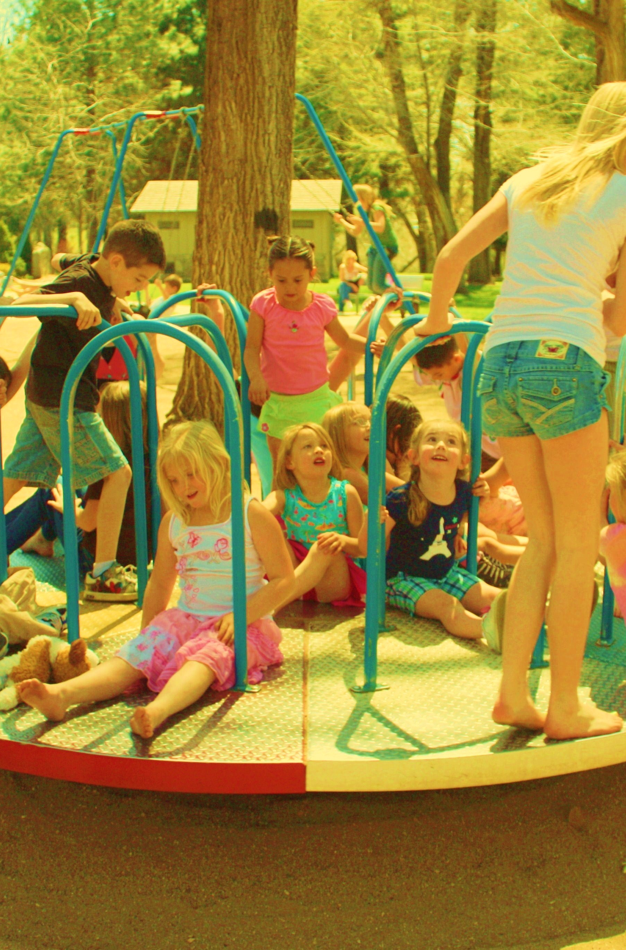
View the Internet as a place
Would you let your child go out alone without first asking where they are going?
...who with?
...without setting boundaries?

Slide 7

Where are you going?
Would you allow your child to go somewhere that was not age appropriate?
What goes on the internet stays on the internet - can you think of examples of professionals who have had online activity come back to haunt them?
Faking your age involves lying and exposes young children to inappropriate content
Stay up to date with apps and sites that are popular, visit net-aware.org.uk

Slide 8
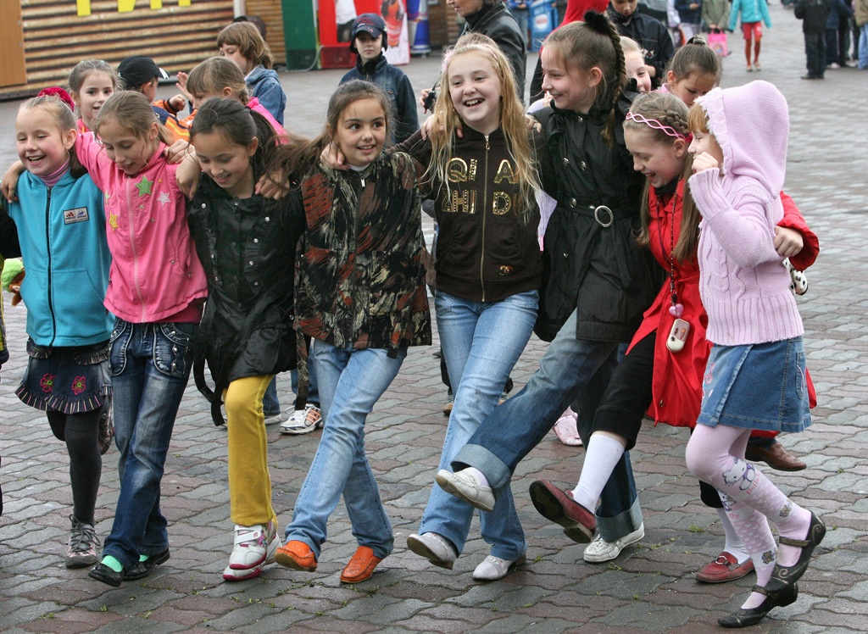


Who are you going with?
Ensure you and your child know how to set privacy settings, block unwanted users and report inappropriate content on major social networking sites Stay up to date with apps and sites that are popular, visit http://h2bsafetycentre.com

Slide 9
Setting rules & boundaries
It is useful to agree rules together
When they go online
How long for
Sharing images and video
Websites and apps they can use
How to treat people

Slide 10
Quick tips
Talk to your child about their online activity early and often
Explore online together
Know who your child is talking to
Make sure the content is age appropriate
Use parental controls
Check your child knows about privacy settings etc

